Slide 2
Mixed Reality with Xamarin and Azure Spatial Anchors
Dhave P. Dayao
Senior Xamarin Developer / XAM Consulting
https://xambuddy.github.io/

Slide 3
What is Xamarin?

Slide 4
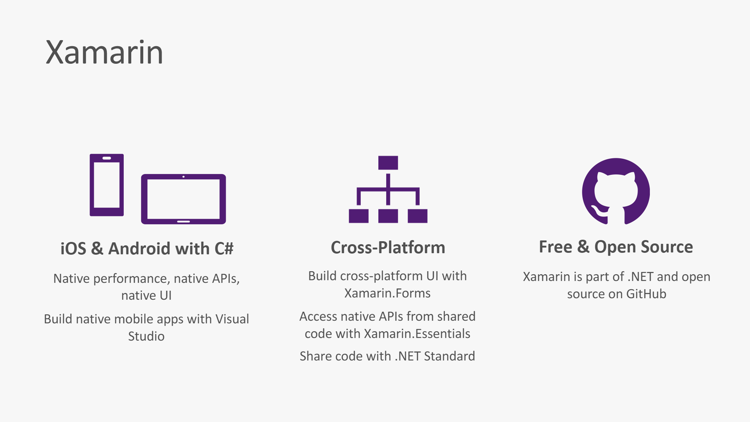

Slide 5
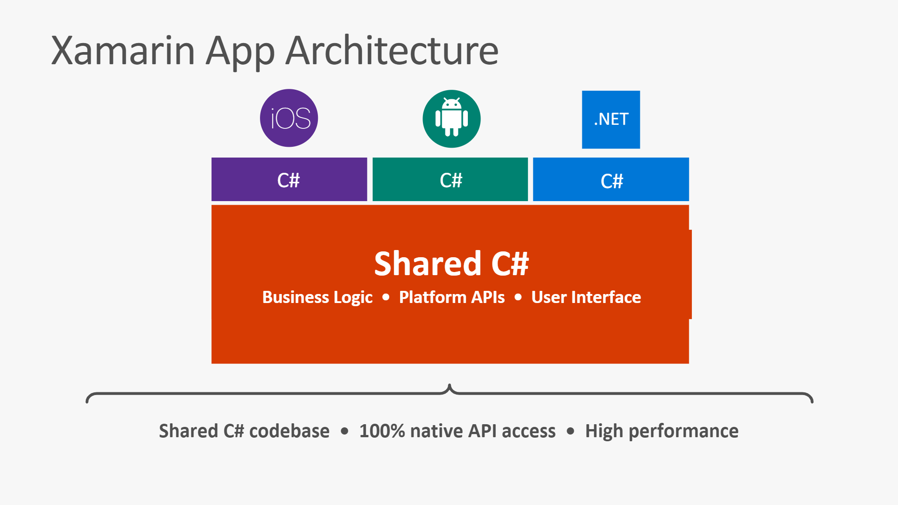

Slide 6
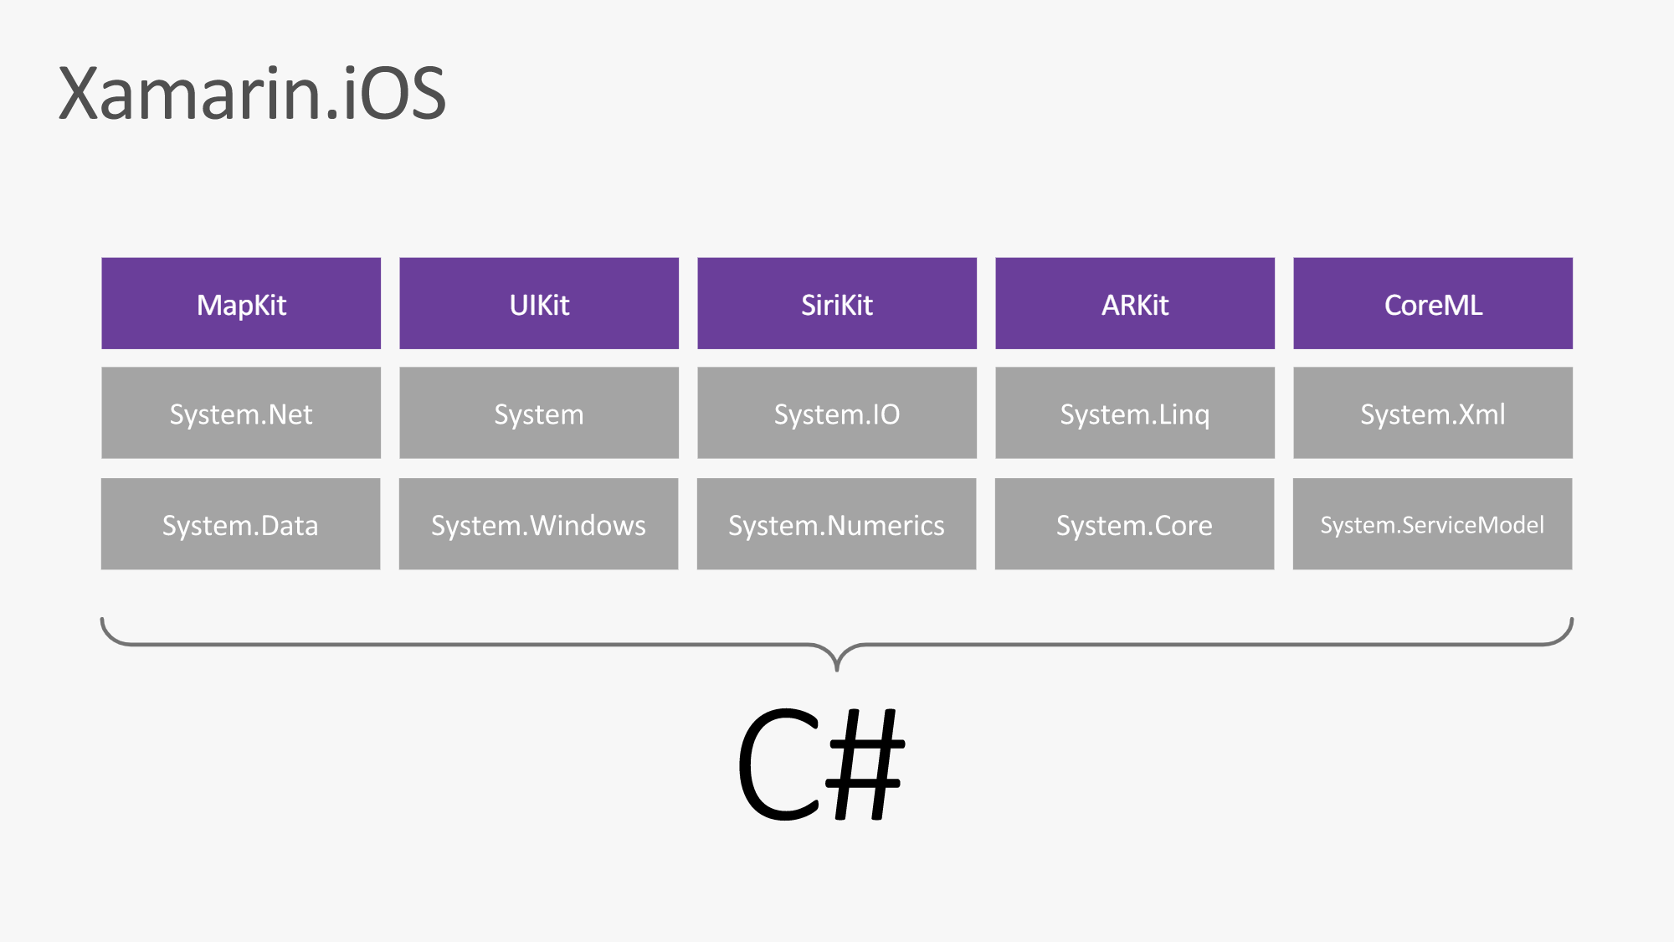

Slide 7
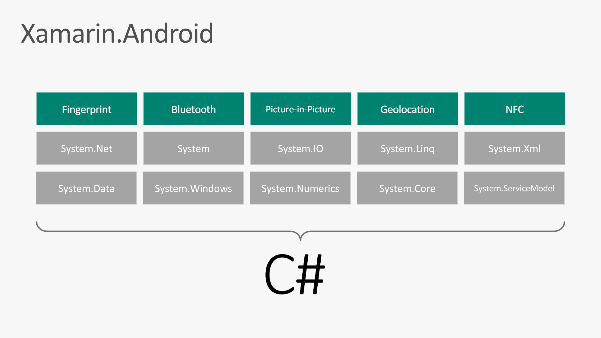

Slide 8
What is Augmented Reality?

Slide 9
Feature being leveraged is Camera + Augmented Reality
Objects are virtually drawn on screens on real world coordinates + spatial location
Native :
ARKit/SceneKit – iOS
ARCore/SceneForm - Android

Slide 10
What is Azure Spatial Anchors?

Slide 11
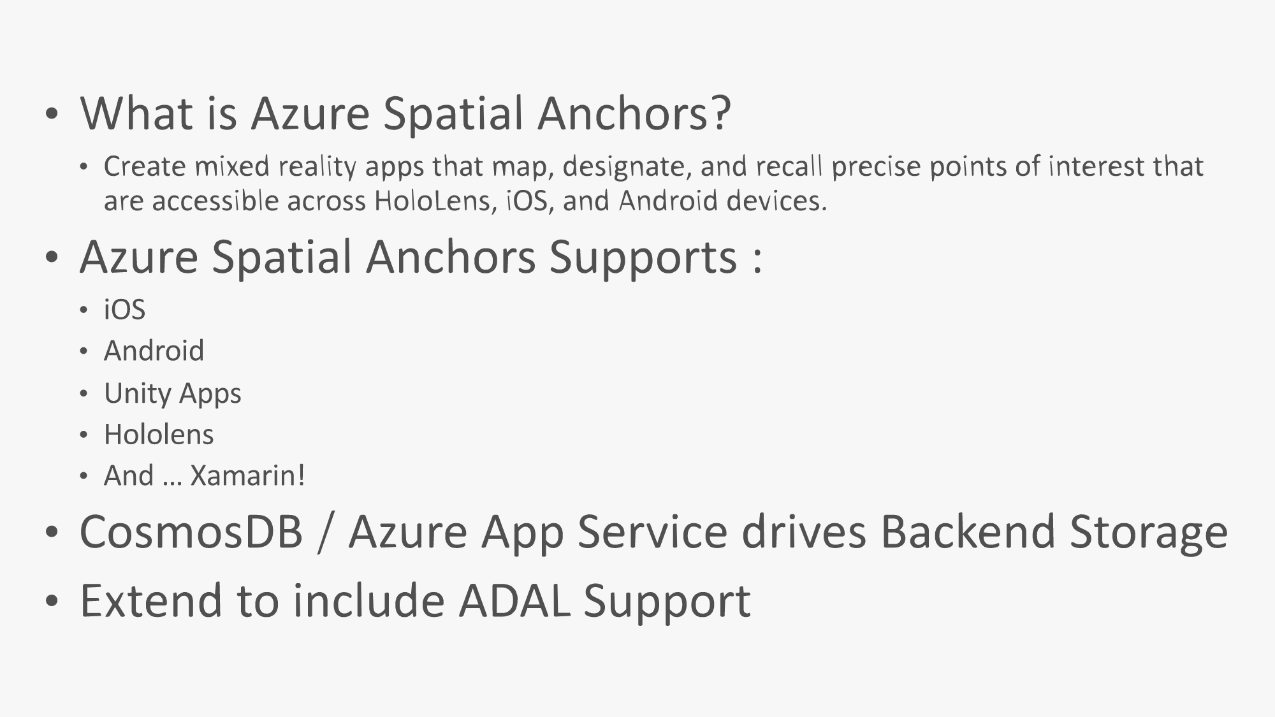

Slide 12
Supported Devices

Slide 13
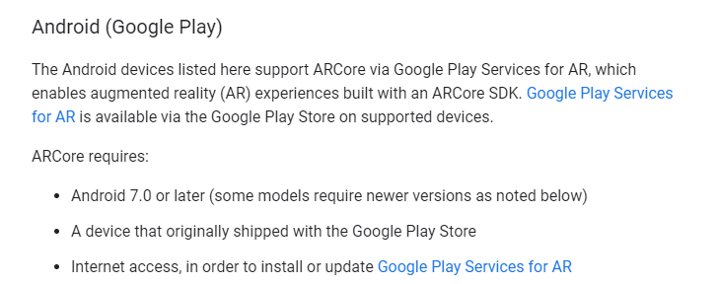
Link: https://developers.google.com/ar/discover/supported-devices

Slide 14
Puzzle Anchors Hunt! Code : https://github.com/xambuddy/PuzzleAnchorsHunt

Slide 15
Code Sample Title

